Slide 1
Facilitator Instructions
The facilitator should be prepared to support and guide students as they lead the peer-to-peer road safety presentation. The goal is to create an open, respectful environment where students feel comfortable sharing their thoughts and engaging their peers.
Assign student leaders by chapter: Each chapter or section of the presentation can be led by a different student or small group of students. Encourage them to review their section ahead of time.
Support student leaders: Provide guidance, help clarify content, and step in if students need assistance, but allow them to take the lead in presenting and facilitating discussions.
Set expectations: Remind students that discussions are respectful, and everyone’s input is valued.
Engage the group: Encourage questions, sharing of experiences, and active participation throughout the session.
Use examples and scenarios: Help students relate the content to real-life situations, emphasizing safe decision-making and the consequences of distracted driving.
Wrap up with key takeaways: Summarize the main points, highlight actionable steps, and remind students of resources or contacts if they have questions later.
Optional: Encourage students to share what they learned with friends and family to reinforce the importance of road safety.

Slide 2

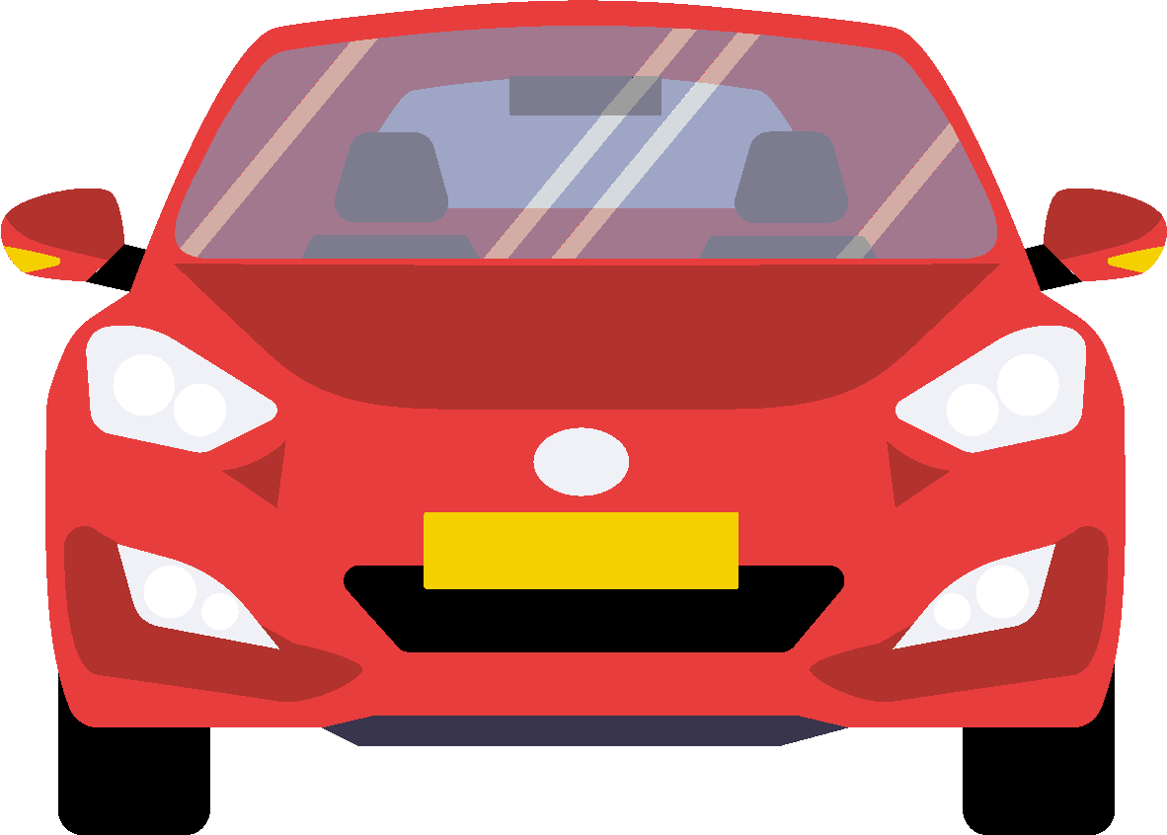

D͛⦚i͛⦚s͛⦚t͛⦚r͛⦚a͛⦚c͛⦚t͛⦚e͛⦚d͛⦚!͛⦚
  Eyes on.
  Hands on.
  Mind on.
School LOGO
Presenter Names Here

Slide 3










Program Contributors

Slide 4

MODULES
What is Distracted Driving?
Some Statistics
  A) Vermont
  B) New Hampshire
The Laws of Distraction
  A) New Hampshire
  B) Vermont
Driving Distraction-Free
Interactive Activities
  Name that Distraction
  Role Play
Take Action: What you can do to limit distractions

Slide 5
What is Distracted Driving?

Slide 6

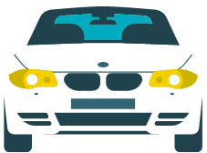

According to the National Highway Traffic Safety Administration (NHTSA) distracted driving is ANY activity that diverts attention from driving.
If it impacts your focus or redirects your attention, it’s a distraction.
Notes:
Possibly changing the word “diverts” to redirects and adding in a sentence for focusing.

Slide 7



Name
the Distractions!
Directions:
As a group or as individuals, brainstorm the types of distracted driving you have seen
Notes:
White board activity: Identify a specific distraction
In-person: Please use the post it notes and put one distraction you see while in a car. You can place as many distractions on the white board as you can.
Online: Please use the chat to list one distraction you see while in a car
Presentation notes: acknowledge the list of distractions that our peers are seeing. And add what you think is missing while discussing the list.
Activity Slide-Place Activity Title Here.
Example: White Board Activity.
In-person: Have your peers and/or parents/caregivers use post-it notes and put one distraction they see on the post it note and place it on the classroom white board or surface where everyone can see. If supplies (white board markers) are available you could also have the students and/or parents/caregivers write the distractions on the white board.
Online: Use the chat to have everyone list one distraction they see while in a car.
For more activity ideas please the module listed as
AAA Peer to Peer Activities Sheet

Slide 8



3 Types of Distractions
Visual
Taking your eyes off the road
Texting
Staring at a roadside crash, major attractions, billboards or pedestrians
Manual
Taking your hands off the wheel
Eating or drinking
Adjusting car settings, such as heat or radio
Cognitive
Taking your mind off driving.
Talking to passengers
Talking on cell phones

Slide 9

Have you ever…
Been in a vehicle with a distracted driver?
Been distracted while driving a vehicle?
Notes:
Take a moment to Discuss and share stories.

Slide 10

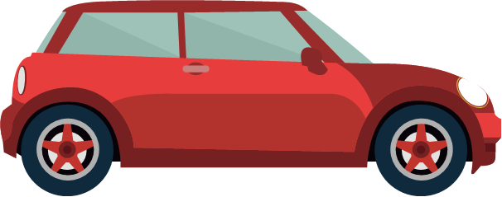
The most common forms of distraction leading to a teen driver crash include:
15% interacting with one or more passengers
12% using a cellphone
10% looking at something in the vehicle
9% looking at something outside the vehicle
8% Singing/Dancing to music
6% Grooming
6% Reaching for an object
*In-vehicle video (using DriveCam) studies found that distraction was a factor in 58% of teen crashes, a much higher rate than federal estimates.
Source: AAA Teen Driving & AAA Foundation for Traffic Safety

Slide 11
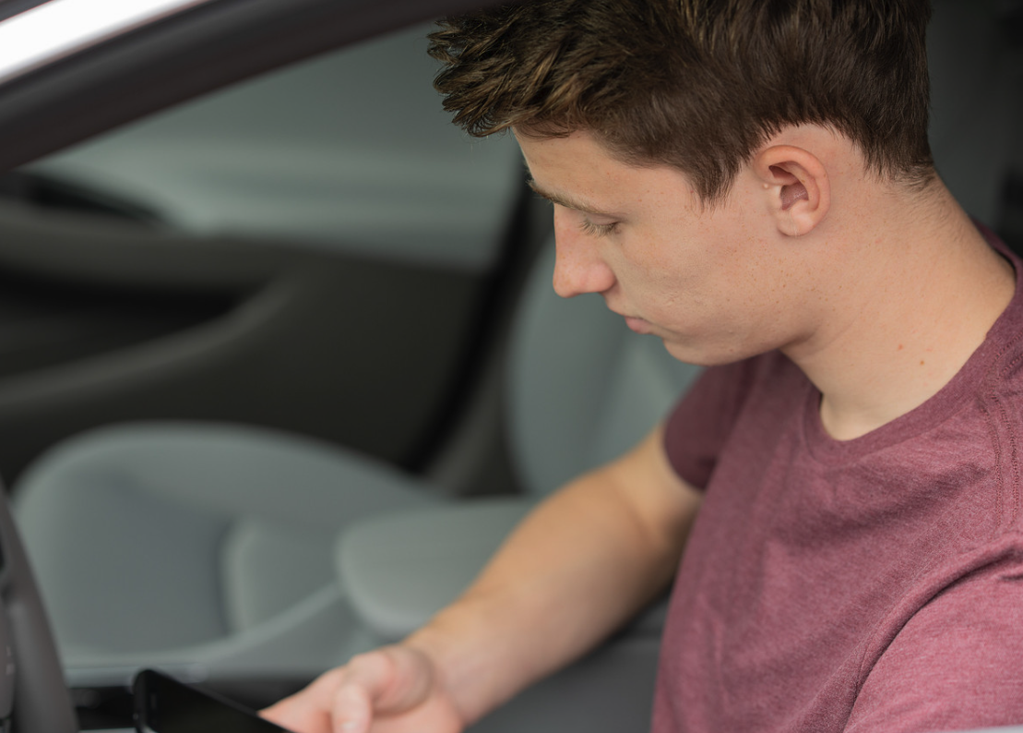
Public perception vs. reality
Most drivers (97%) believe texting, posting, and emailing while driving is a serious safety threat.
However, 45% have read texts or emails, and nearly 35% have typed them in the past month.
Source: AAA Foundation for Traffic Safety, 2025 Traffic Safety Culture Index Survey

Slide 12
Understanding Distraction
Eyes off the Road
Hands off the Wheel
Mind off the Drive
Staring at crashes
Reading signs
Reading maps
Texting
Reaching for fallen objects
Personal grooming
Changing the radio
Drinking or eating
Turning on the A/C
Talking to passengers
Talking on a hands-free phone call

Slide 13
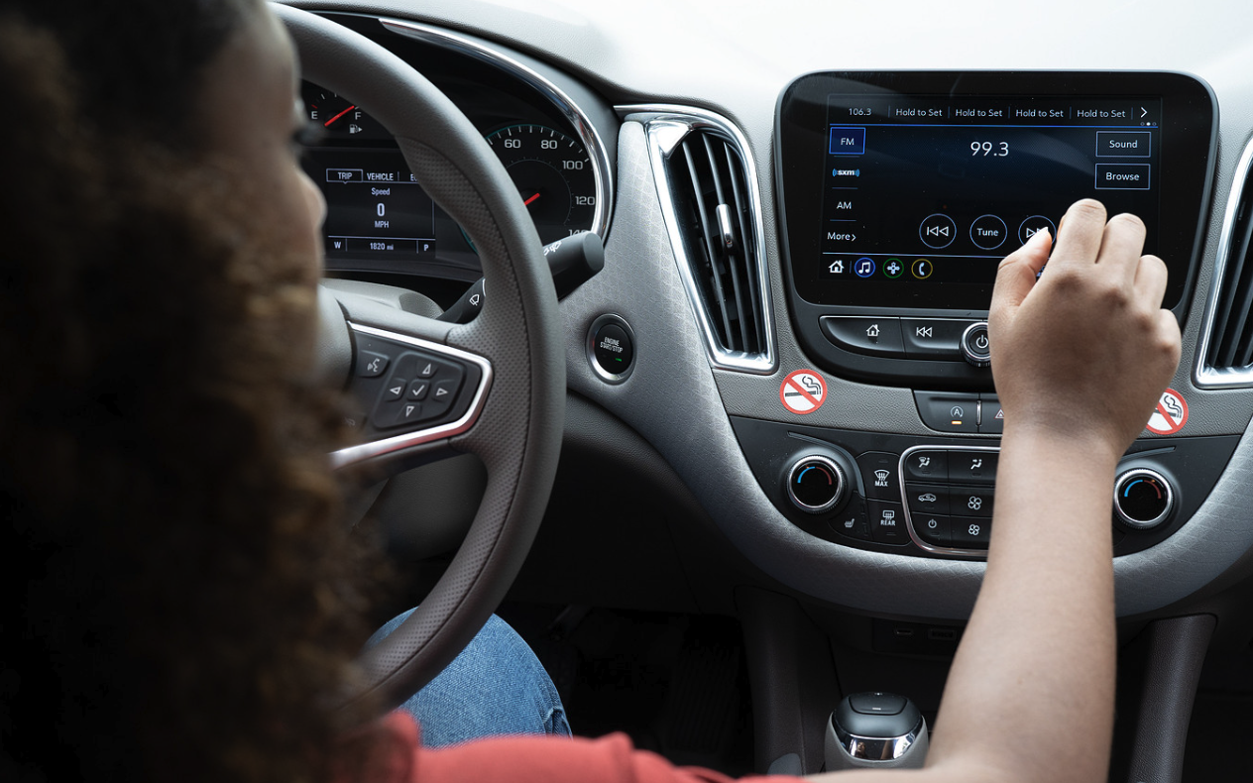
Cognitive Distraction
Multitasking is a myth! Interacting with in-car systems can suppress brain activity needed for safe driving, increase reaction times, and lead to missed cues.
"Intexticated" effect:
Even after a driver finishes using a smartphone, the brain can take up to 30 seconds to refocus on driving, a state sometimes called "intexticated". This can lead to inattention blindness, where drivers look at the road but don't see what is in front of them.

Slide 14
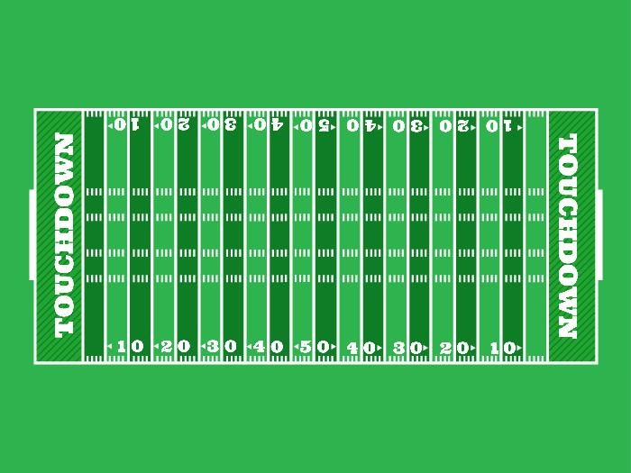
Did you know?
At 55 miles per hour, sending or reading a text is like driving the length of a football field with your eyes closed.
Notes:
Presenter notes: 100 yards, 300 feet
Activity: Blind fold a student and have them walk that distance (if space allows and is safe to do)

Slide 15
Some Statistics

Slide 16

Vermont: By the Numbers
Between 2021 and 2022, fewer people felt they were less likely to be ticketed for unsafe behaviors or rather more people thought unsafe behaviors were more likely to result in a ticket from law enforcement.
 | 2021 | 2022
Driving over the posted speed limit | 82.4% | 75.6%
Using a hand-held electronic device (such as to talk or text) | 76.4% | 66.4%
Not wearing seatbelts | 62.4% | 53.6%
2022 VERMONT STATE HIGHWAY SAFETY OFFICE ATTITUDE SURVEY RESULTS

Slide 17
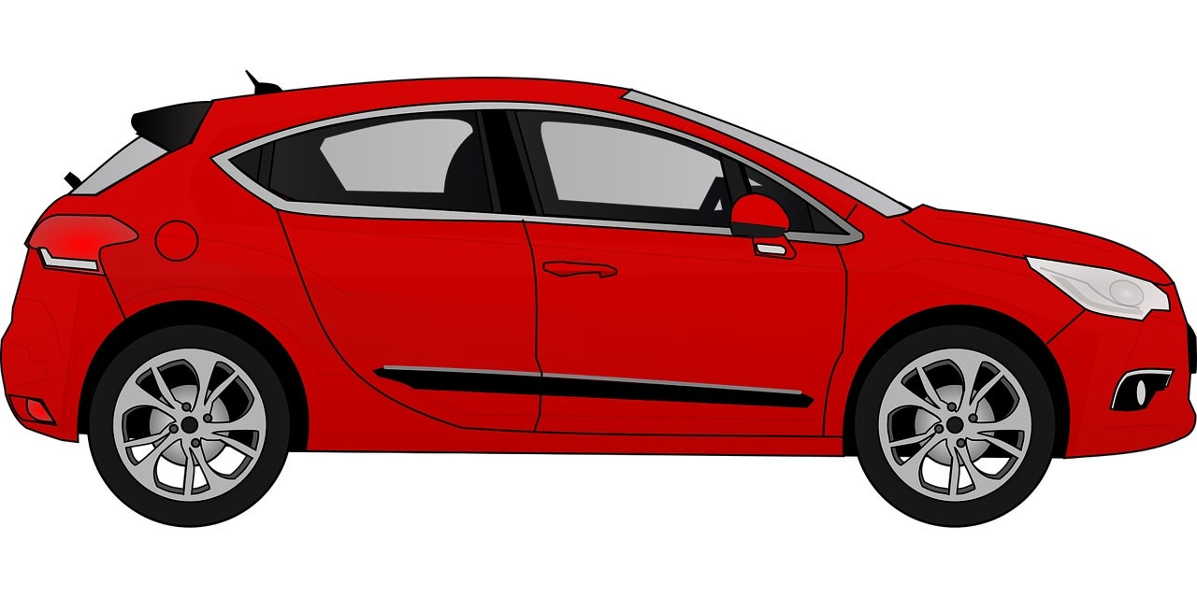

Vermont Data-Youth Risk Behavior Survey (YRBS)
The 2023 YRBS showed that among students who drive, nearly four in ten (38%) reported texting or emailing while driving at least once during the past 30 days.
*No significant change between 2017 to 2019 or 2013.

Slide 18

Over half of Vermont drivers have never used a device while driving
53%
The majority of Vermont drivers see even hands-free phone use as unsafe
61%
STATE OF VERMONT DISTRACTED DRIVING OBSERVATION RESULTS 2022 FINAL REPORT

Slide 19
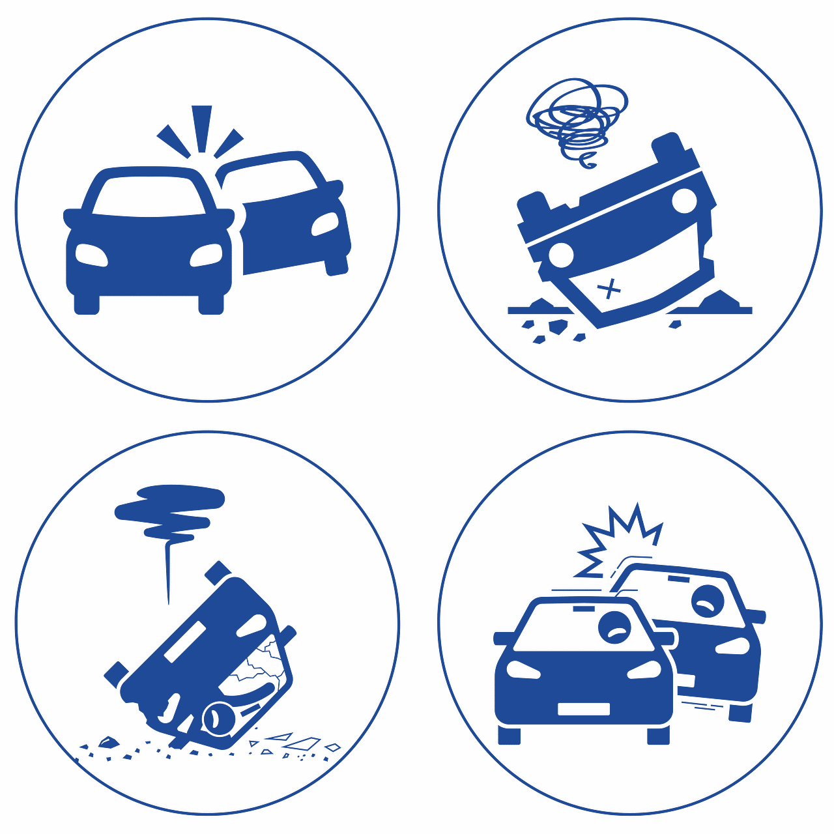

New Hampshire Data
42 fatal crashes in New Hampshire with distraction or inattention as the primary causation from 2014 through 2020.
NEW HAMPSHIRE DEPARTMENTS OF INSURANCE AND SAFETY REMIND GRANITE STATERS THAT APRIL IS DISTRACTED DRIVING AWARENESS MONTH

Slide 20
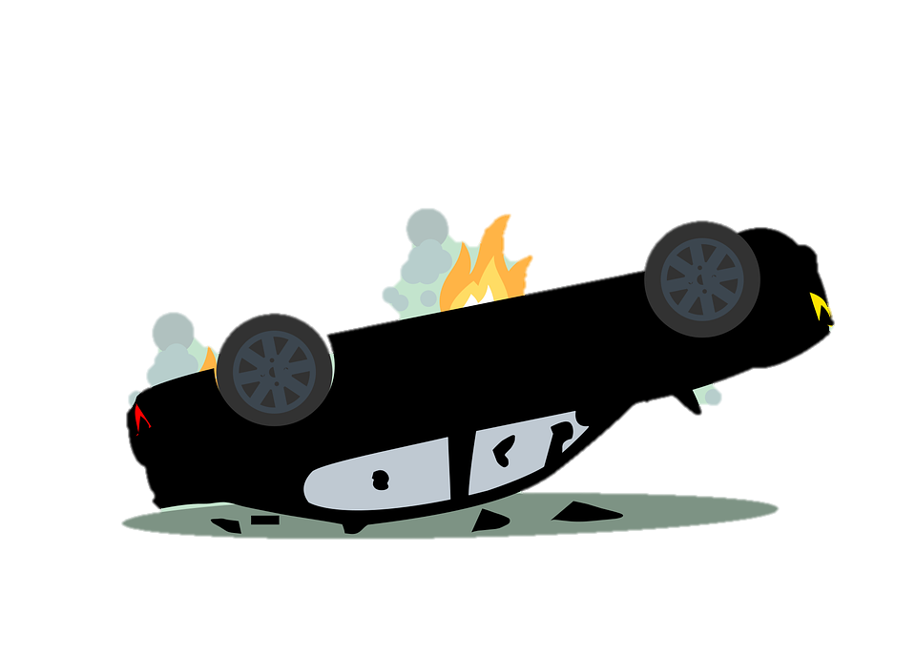
In 2020, Distracted Driving accounted for almost a third of all crashes in New Hampshire.
30%
NEW HAMPSHIRE DEPARTMENTS OF INSURANCE AND SAFETY REMIND GRANITE STATERS THAT APRIL IS DISTRACTED DRIVING AWARENESS MONTH

Slide 21
New Hampshire by the Numbers
2021 Youth Risk Behavior Survey Questions | Your County | Your School (If you have this data) | New Hampshire (%)
Percentage of students who texted or e-mailed while driving a car or other vehicle (on at least 1 day during the 30 days before the survey, among students who had driven a car or other vehicle during the 30 days before the survey) |  |  | 42.9%
Percent of students who did not always wear a seat belt (when riding in a care driven by someone else) |  |  | 32.6%
Notes:
Do a little research to see if you can find this information. For your school’s data consider doing a survey. You can use a platform like google forms, or online polling tools.

Slide 22
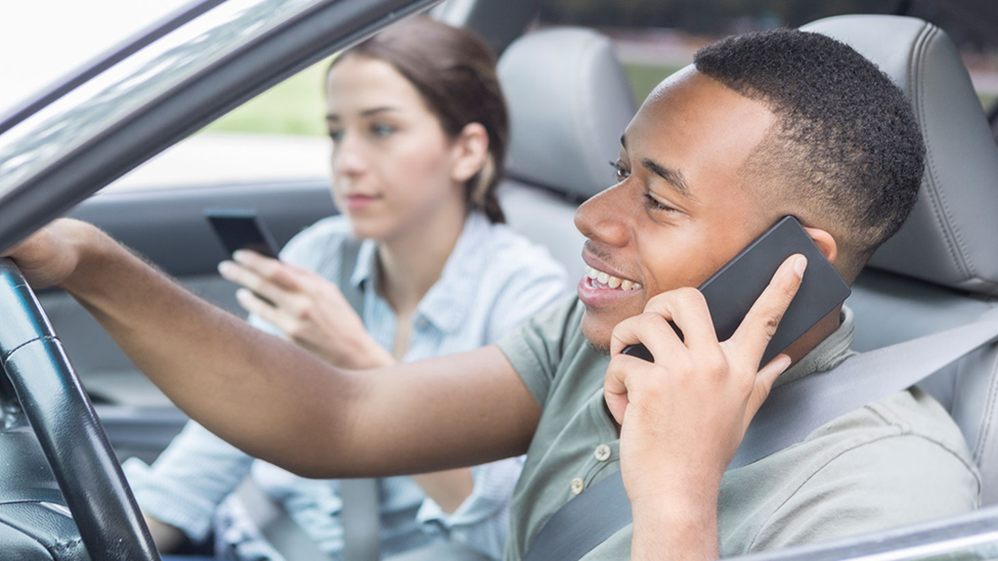



What could the passenger be doing to help the driver?
Notes:
The driver should not be using his phone while driving. The passenger could encourage the driver to pull over to make a call or wait. As you

Slide 23
The LAWS of Distraction

Slide 24

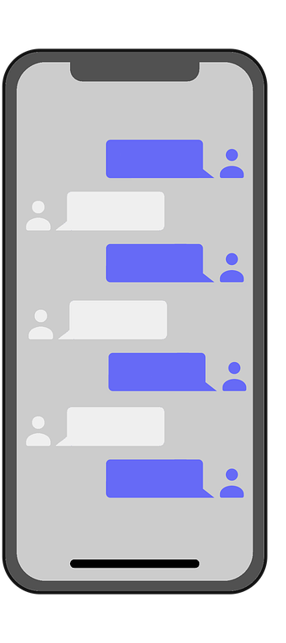
New Hampshire: Hands-Free Law
Effective on July 1, 2015
265:79-c Use of Mobile Electronic Devices While Driving; Prohibition
No person, while driving a moving motor vehicle upon a way or temporarily halted in traffic for a traffic control device or other momentary delay, shall use any hand-held mobile electronic device capable of providing voice or data communication, including but not limited to: reading, composing, viewing, or posting any electronic message; or initiating, receiving, or conducting a conversation; or initiating a command or request to access the Internet; or inputting information into a global positioning system or navigation device; or manually typing data into any other portable electronic device. An operator of a motor vehicle who holds a cellular telephone or other electronic device capable of voice communication in the immediate proximity of his or her ear while such vehicle is in motion is presumed to be engaging in a call within the meaning of this section.
Notes:
265:79-c Use of Mobile Electronic Devices While Driving; Prohibition. –
I. (a) No person, while driving a moving motor vehicle upon a way or temporarily halted in traffic for a traffic control device or other momentary delay, shall use any hand-held mobile electronic device capable of providing voice or data communication, including but not limited to: reading, composing, viewing, or posting any electronic message; or initiating, receiving, or conducting a conversation; or initiating a command or request to access the Internet; or inputting information into a global positioning system or navigation device; or manually typing data into any other portable electronic device. An operator of a motor vehicle who holds a cellular telephone or other electronic device capable of voice communication in the immediate proximity of his or her ear while such vehicle is in motion is presumed to be engaging in a call within the meaning of this section.
(b) "Driving,'' for the purposes of this section, shall not include when a person is behind the controls of a vehicle that has pulled to the side of or off the road at a location where it is legal to do so and where the vehicle remains stationary.
II. It shall not be an offense under this section for any person driving a motor vehicle upon a way:
(a) To make use of a cellular telephone or other electronic device capable of voice communication to report an emergency to the enhanced 911 system or directly to a law enforcement agency, fire department, or emergency medical provider.
(b) To use one hand to transmit or receive messages on any non-cellular 2-way radio.
(c) To use a Bluetooth enabled or other hands-free electronic device, or a similar device that is physically or electronically integrated into a motor vehicle, for such a purpose to send or receive information provided the driver does not have to divert his or her attention from the road ahead. As used in this section, "hands-free electronic device'' means a mobile electronic device that has an internal feature or function, or that is equipped with an attachment or addition, whether or not permanently part of such mobile electronic device, by which a user engages in conversation without the use of either hand; provided, however, this definition shall not preclude the use of either hand merely to activate, deactivate, or initiate a function of the telephone.
(d) To perform any action required by an ignition interlock device.
III. Any person who violates this section shall be guilty of a violation and shall be fined $100 plus penalty assessment for a first offense, $250 plus penalty assessment for a second offense, and $500 plus penalty assessment for any subsequent offense within a 24-month period.
IV. No person less than 18 years of age shall use a cellular or mobile telephone or other mobile electronic device, whether hands-free or not, while driving a motor vehicle in motion or temporarily stopped in traffic upon any way, except to report an emergency to the enhanced 911 system or any public safety agency. A person violating this paragraph shall be subject to the fines in paragraph III and license suspension or revocation under RSA 263:14, III.
V. Nothing in this section shall prohibit a driver, regardless of age, from receiving aural routing information from a hands-free global positioning device or navigation service through a mobile electronic device; or receiving turn-by-turn routing information from the screen of a global positioning device or navigation service through a mobile electronic device that is integrated into the vehicle or mounted on the dashboard, windshield, or visor of the vehicle.

Slide 25
Vermont: Hands-Free Law
23 V.S.A 1095b
A person shall not operate upon a highway in this State a moving motor vehicle carrying or having installed a screen or other device transmitting a moving entertainment picture that is visible to the operator.
Notes:
§ 1095. Entertainment picture visible to the operator
A person shall not operate upon a highway in this State a moving motor vehicle carrying or having installed a screen or other device transmitting a moving entertainment picture that is visible to the operator. (Added 1971, No. 258 (A
Subchapter 009 : Violations and Penalties
(Cite as: 23 V.S.A. § 1095b)
§ 1095b. Handheld use of portable electronic device prohibited
(a) Definitions. As used in this section:
(1) “Hands-free use” means the use of a portable electronic device without utilizing either hand by employing an internal feature of, or an attachment to, the device or a motor vehicle.
(2) “Public highway” means a State or municipal highway as defined in 19 V.S.A. § 1(12).
(3) “Securely mounted” means the portable electronic device is placed in an accessory specifically designed or built to support the hands-free use of a portable electronic device that is not affixed to the windshield in violation of section 1125 of this title and either:
(A) is utilized in accordance with manufacturer specifications; or
(B) causes the portable electronic device to remain completely stationary under typical driving conditions.
(4) “Use” means the use of a portable electronic device in any way that is not a hands-free use, including an operator of a motor vehicle holding a portable electronic device in the operator’s hand or hands while operating a motor vehicle.
(b) Use of handheld portable electronic device prohibited.
(1) An individual shall not use a portable electronic device while operating:
(A) a moving motor vehicle in a place open temporarily or permanently to public or general circulation of vehicles; or
(B) a motor vehicle on a public highway in Vermont, including while the vehicle is stationary, including while temporarily stationary because of traffic, a traffic control device, or other temporary delays.
(2) The prohibitions of this subsection shall not apply:
(A) to hands-free use;
(B) to activation or deactivation of hands-free use, provided the portable electronic device is securely mounted or the activation or deactivation is done through an internal feature of the device or the motor vehicle being operated and without the operator utilizing either hand to hold the portable electronic device;
(C) when use of a portable electronic device is necessary for an individual to communicate with law enforcement or emergency service personnel under emergency circumstances or in response to a direction or order from law enforcement;
(D) to use of an ignition interlock device, as defined in section 1200 of this title;
(E) to use of a global positioning or navigation system if it is installed by the manufacturer or securely mounted in the vehicle; or
(F) when the operator has moved the motor vehicle to the side of or off the public highway and has halted, with or without the motor running, in a location where the vehicle can safely and lawfully remain stationary.
(c) Penalties.
(1) An individual who violates this section commits a traffic violation and shall be subject to a civil penalty of not less than $100.00 and not more than $200.00 for a first violation, and of not less than $250.00 and not more than $500.00 for a second or subsequent violation within any two-year period.
(2) An individual convicted of violating this section while operating within the following areas shall be subject to a civil penalty of not less than $200.00 and not more than $400.00 for a first violation, and of not less than $500.00 and not more than $1,000.00 for a second or subsequent violation within any two-year period and shall have four points assessed against his or her driving record for a first conviction and five points assessed for a second or subsequent conviction:
(A) a properly designated work zone in which construction, maintenance, or utility personnel are present; or
(B) a school zone marked with warning signs conforming to the Manual on Uniform Traffic Control Devices.
(3) An individual convicted of violating this section outside the areas designated in subdivision (2) of this subsection shall have two points assessed against his or her driving record.
(d) Commercial motor vehicles.
(1) Operators of commercial motor vehicles shall be governed by the provisions of chapter 39 of this title (Commercial Driver’s License Act) instead of the provisions of this chapter with respect to the handheld use of mobile telephones and texting while operating a commercial motor vehicle.
(2) An individual shall not be issued more than one complaint for any violation of this section, section 1095a of this title (junior operator use of portable electronic devices), or section 1099 of this title (texting prohibited) that arises from the same incident.
§ 1099. Texting prohibited
(a) As used in this section, “texting” means the reading or the manual composing or sending of electronic communications, including text messages, instant messages, or e-mails, using a portable electronic device as defined in subdivision 4(82) of this title. Use of a global positioning or navigation system shall be governed by section 1095b of this title.
(b)(1) An individual shall not engage in texting while operating a moving motor vehicle in a place open temporarily or permanently to public or general circulation of vehicles.
(2) In addition, an individual shall not engage in texting while operating a motor vehicle on a public highway in Vermont, including while the vehicle is stationary, unless otherwise provided under this section. As used in this subdivision (b)(2):
(A) “Public highway” means a State or municipal highway as defined in 19 V.S.A. § 1(12).
(B) “Operating” means operating a motor vehicle on a public highway, including while temporarily stationary because of traffic, a traffic control device, or other temporary delays. “Operating” does not include operating a motor vehicle with or without the motor running when the operator has moved the vehicle to the side of or off the public highway and has halted in a location where the vehicle can safely and lawfully remain stationary.
(c)(1) An individual who violates this section commits a traffic violation as defined in section 2302 of this title and shall be subject to a civil penalty of not less than $100.00 and not more than $200.00 for a first violation, and of not less than $250.00 and not more than $500.00 for a second or subsequent violation within any two-year period.
(2) An individual convicted of violating this section while operating within the following areas shall be subject to a civil penalty of not less than $200.00 and not more than $400.00 for a first violation, and of not less than $500.00 and not more than $1,000.00 for a second or subsequent violation within any two-year period and shall have four points assessed against his or her driving record for a first conviction and five points assessed for a second or subsequent conviction:
(A) a properly designated work zone in which construction, maintenance, or utility personnel are present; or
(B) a school zone marked with warning signs conforming to the Manual on Uniform Traffic Control Devices.
(3) An individual convicted of violating this section outside the areas designated in subdivision (2) of this subsection shall have two points assessed against his or her driving record. (

Slide 26
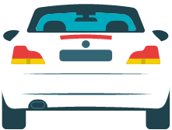
Legal or Illegal?
You can check your phone at a stop sign or a red light
Notes:
(Illegal)

Slide 27
Legal or Illegal?
Drivers can answer the phone through a vehicle speaker or Bluetooth connection
Notes:
(Legal)

Slide 28
Legal or Illegal?
You can have your phone on speaker phone in your cupholder
Notes:
(Illegal)

Slide 29
Legal or Illegal?
Picking up the phone to check the time since your car clock is broken
Notes:
(Illegal)

Slide 30
Legal or Illegal?
Looking at a map on your phone in a holder
Notes:
(Legal)

Slide 31
Name that distraction

Slide 32



Name
That
Distraction!
Visual
Manual
Cognitive
Notes:
We previously discussed the 3 types of distractions. In this activity, Name that Distraction, I/we are going to show you 5 photos and we want you to state what type of distraction it is.

Slide 33
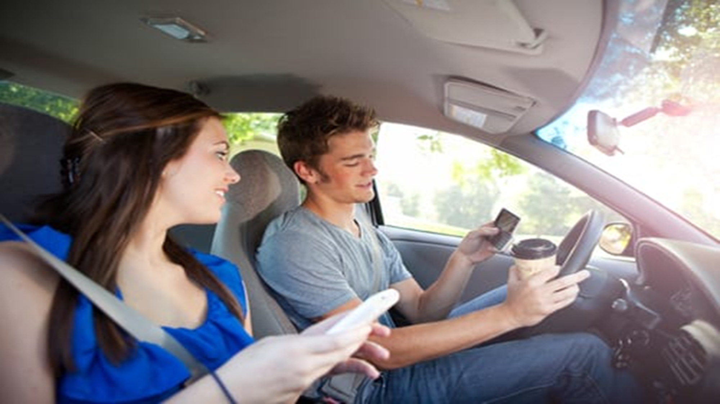
What is unsafe in this picture?
Notes:
Holding a phone, looking at phone, holding hot drink, sitting close to the steering wheel as airbag will cause injuries when sitting too close.

Slide 34
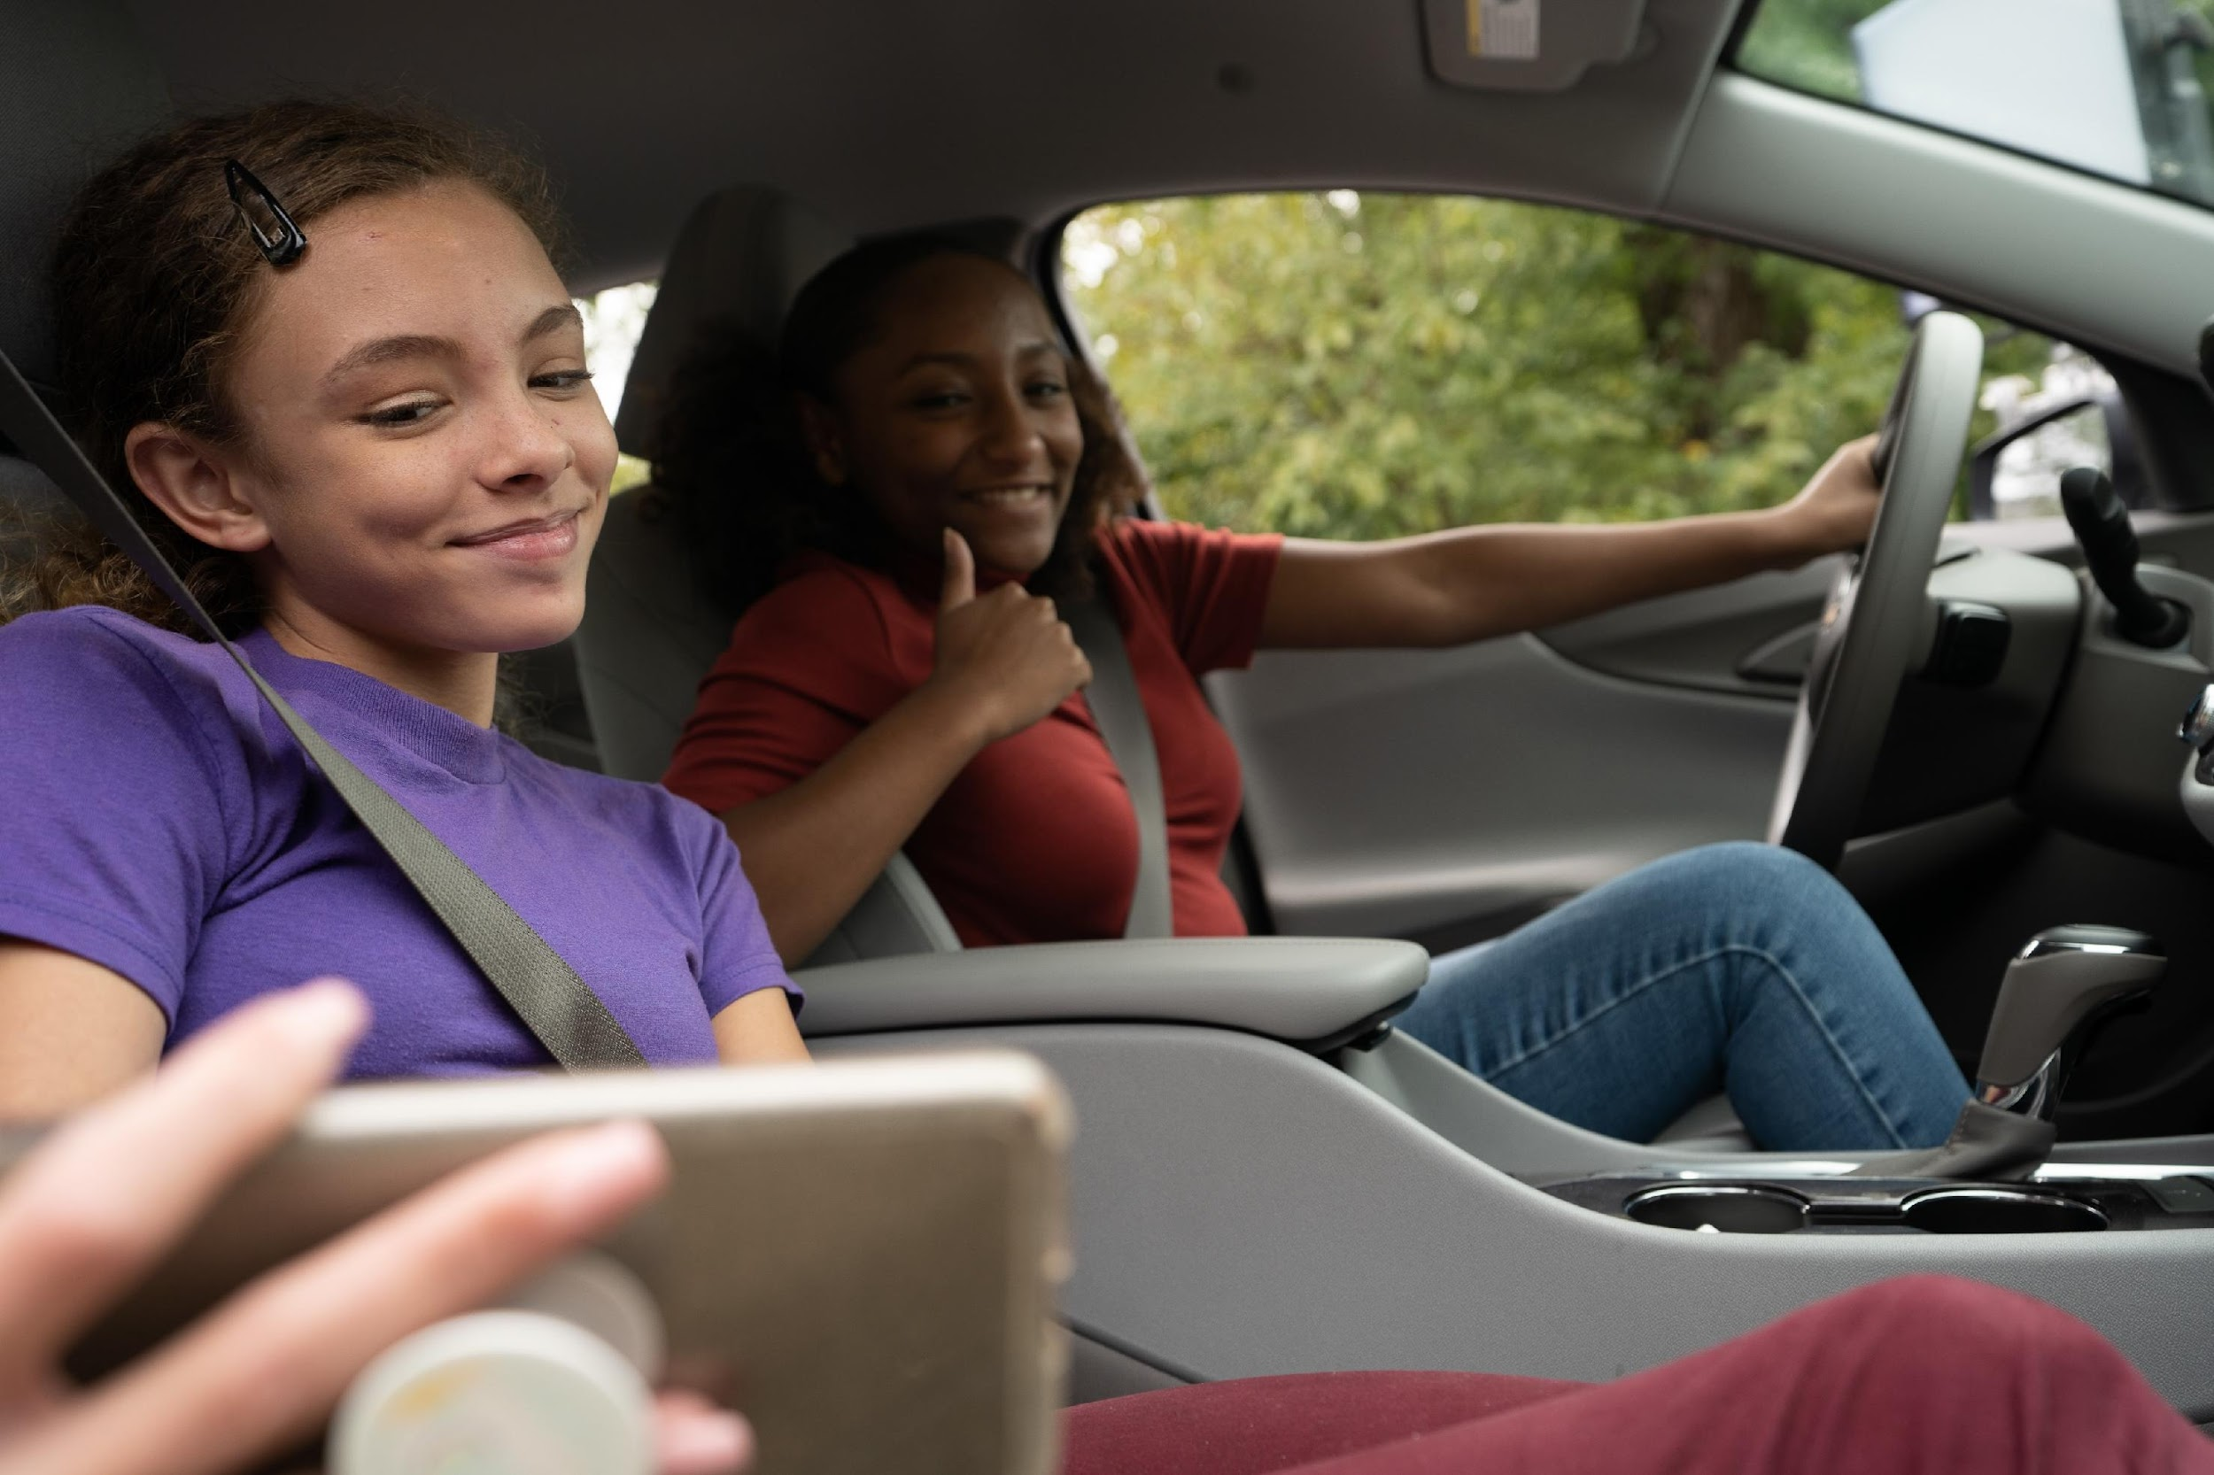
Notes:
Driver’s attention is away from the road

Slide 35
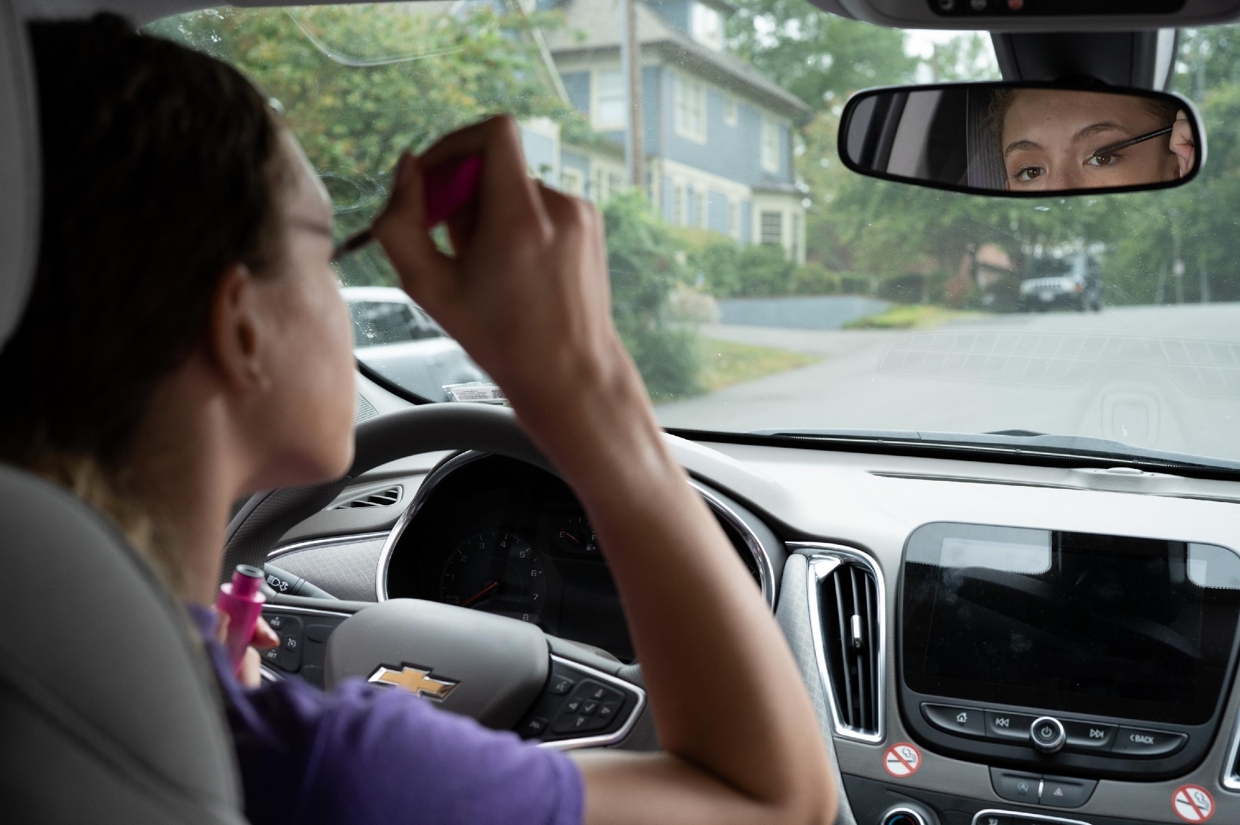
Notes:
Eyes are not on the road, hands are not on the wheel, and attention are way from driving

Slide 36
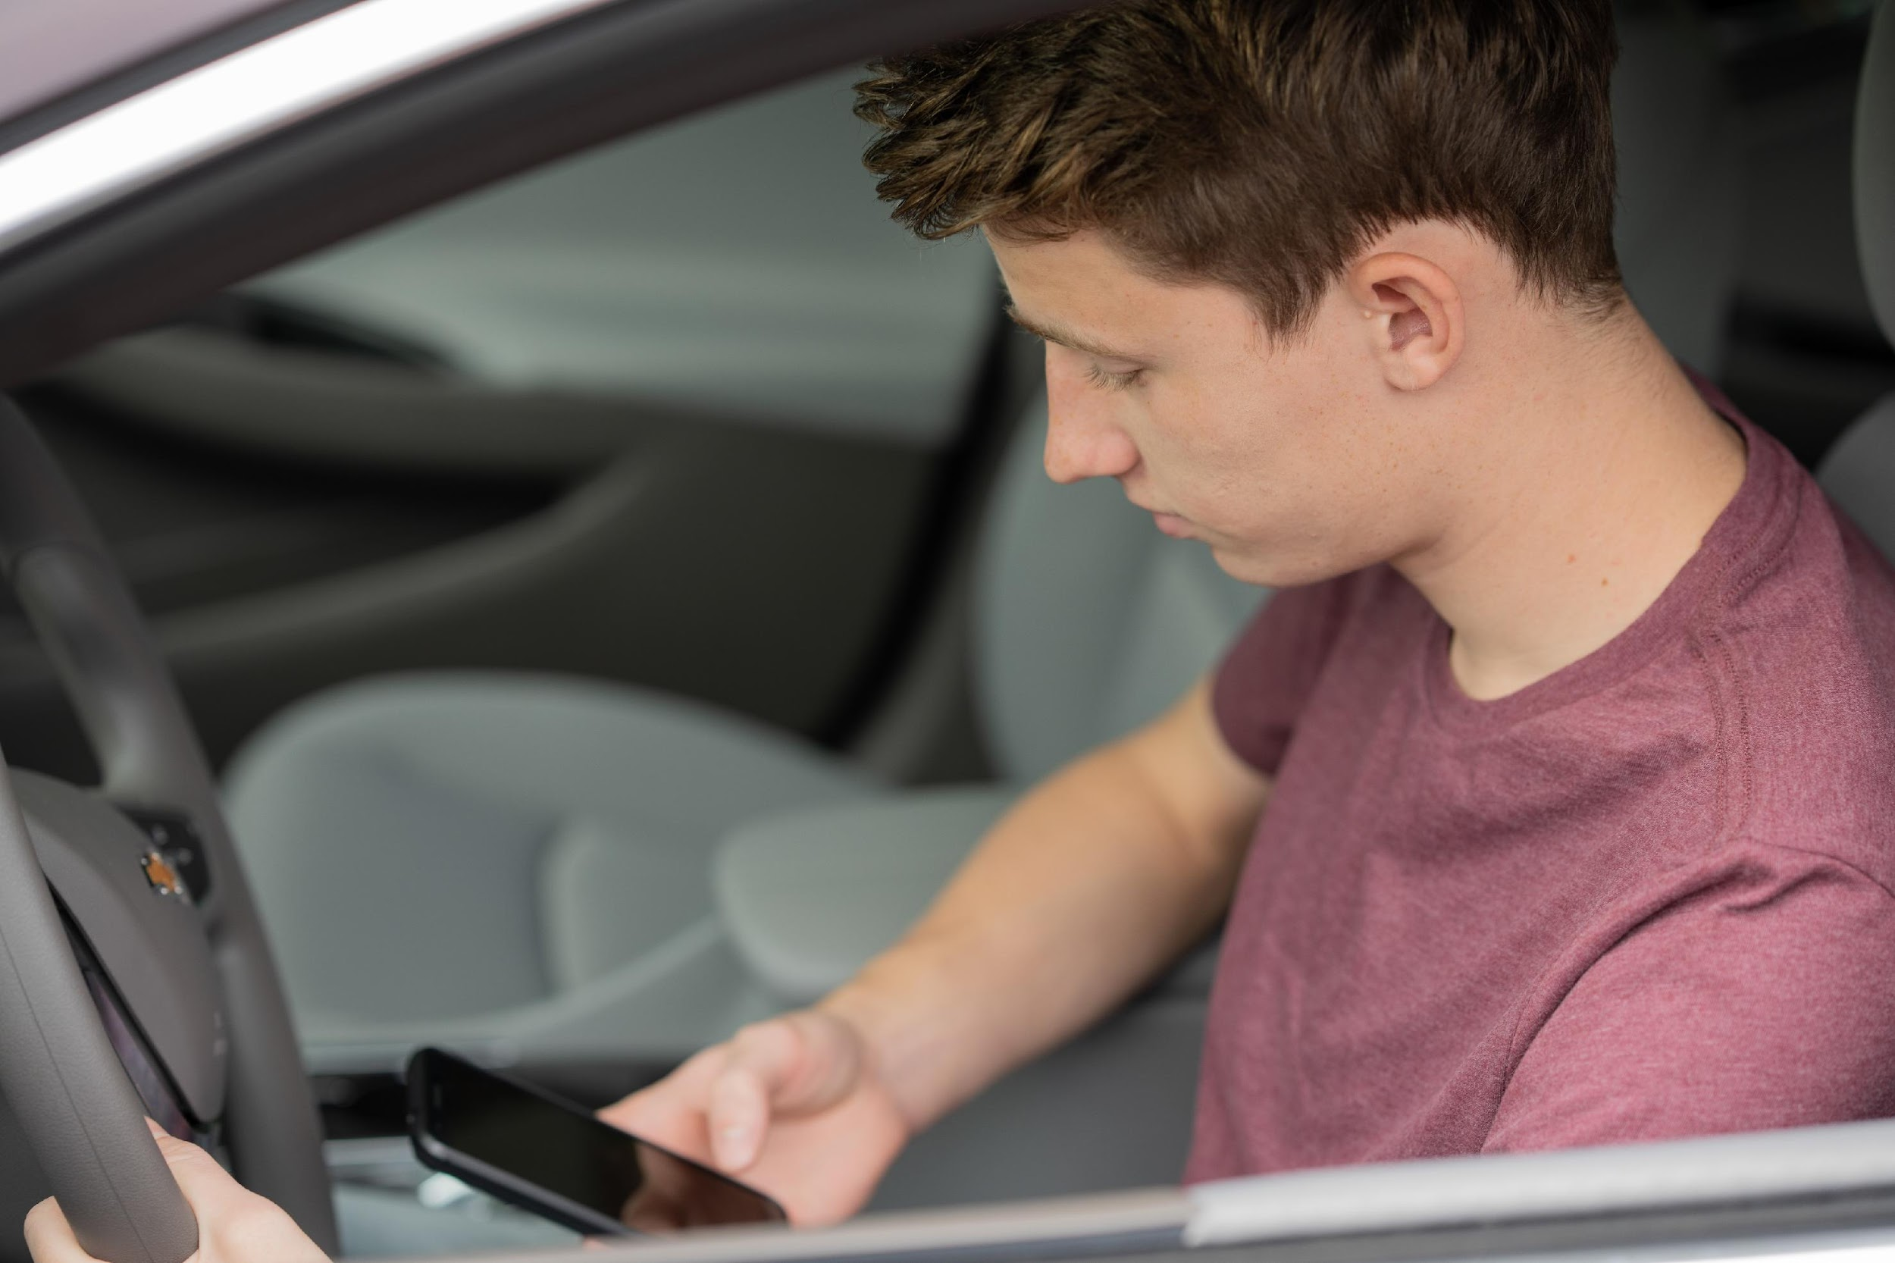
Notes:
Hand is not on the wheel and eyes and attention on not on the road, and not wearing a seatbelt

Slide 37
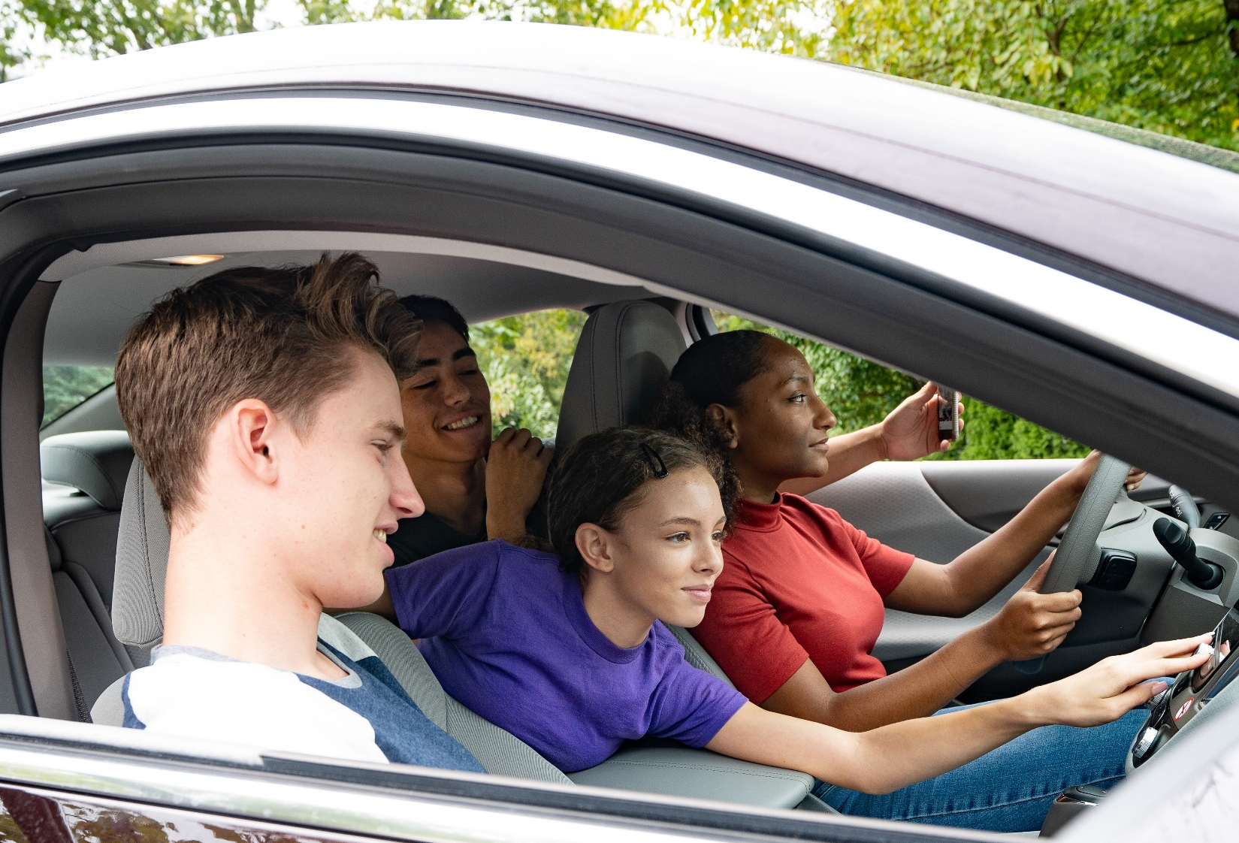
Notes:
No one is wearing a seatbelt putting them at risk of being ejected from the car should they press on the breaks abruptly or crash. The more people in the car the greater the distractions. The driver’s eyes are looking at the phone.

Slide 38
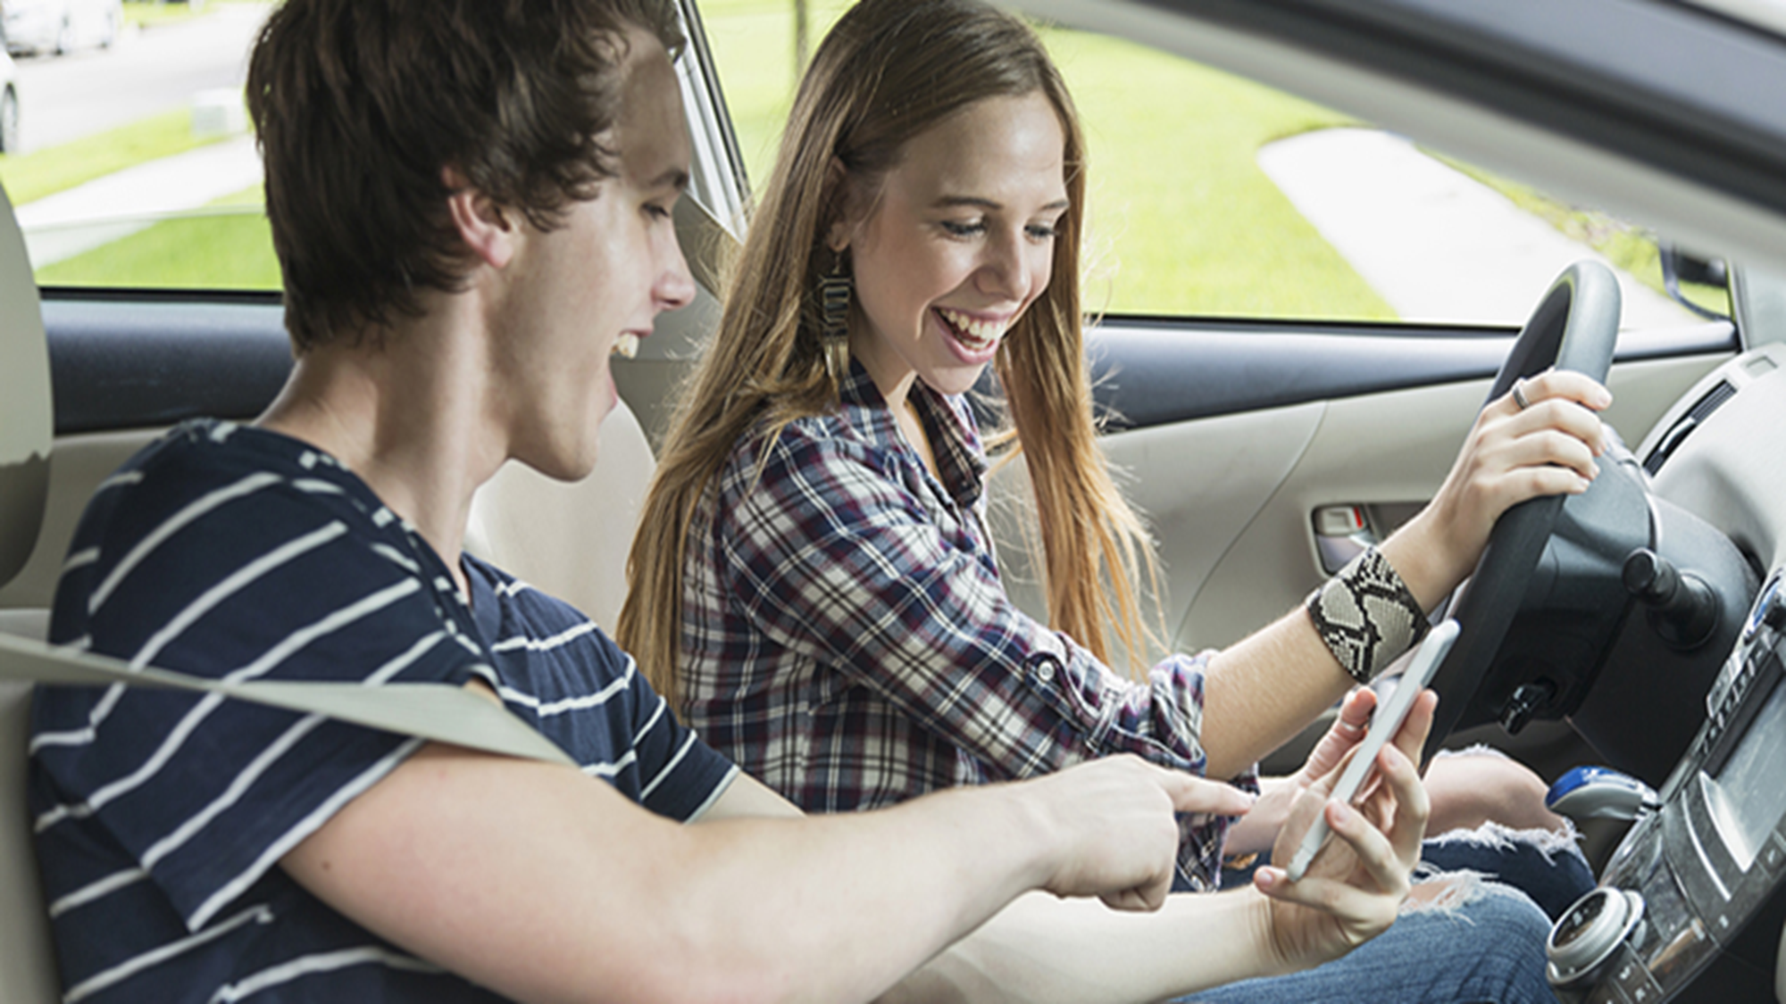
What is unsafe about this picture?
Notes:
The driver is not wearing a seatbelt. The driver is not paying attention or looking at the road.

Slide 39


What if this happened to you?
Role Play Activity

Slide 40
Scenario 1
You and your friend are at a red light. You notice your friend driving reaches for their cell phone and says: “I forgot to remind my parent/guardian that I was going to get coffee with you after school today.”
What would you do?

Slide 41
Scenario 2
A friend’s parent/guardian is giving you a ride home from school and they pick up their phone to text while driving.
What do you do?

Slide 42
Scenario 3
You are driving with friends, and everyone’s favorite song comes on. Your friend in the passenger seat cranks up the volume of the radio.
What do you do?

Slide 43
Scenario 4
You are driving and your friend keeps trying to show you a post on Instagram or make a Tik Tok with you.
What do you do?

Slide 44
Distraction-Free

Slide 45



Driving Distraction-Free

Slide 46

Confirmation Bias
Interpreting new evidence as a confirmation of existing beliefs

Slide 47
Example…
New Evidence:
I drove distracted again and no one was hurt or killed.
Driving distracted is
safe and normal.
New Evidence:
My friend/parent/neighbor drives distracted and never crashed
Notes:
Confirmation bias is a cognitive shortcut that can lead to wrong conclusions. Its a self fulfilling prophecy that overlooks incidences that don’t play into the narrative you want. Like you ignore the near misses, the times the car crossed the center line while distracted. You only remember that nothing bad actually happened.

Slide 48

Breaking the cycle of Confirmation
Talk about it
Talk about it
Talk about it
Right
Wrong

Slide 49

“I feel unsafe when you text and drive. I can check your phone for you or put it on silent so it’s not a distraction.”
Notes:
See something
Say Something (I statements)
Make a plan

Slide 50

“I’m not the best driver when I am distracted. How can I help you be less distracted?”
Notes:
See something
Say Something (I statements)
Make a plan

Slide 51
“I’m still new to driving.
I just need to lower the volume in here so I can focus.”
Notes:
See something
Say Something (I statements)
Make a plan

Slide 52
“I think I might have gone to wrong way. Could you put our destination in the GPS for me and help guide me?”
Notes:
See something
Say Something (I statements)
Make a plan

Slide 53


Create a family driving agreement
Talk about expectations
List behaviors to avoid
List plans to help prevent those behaviors
List consequences for engaging in those behaviors
Everybody signs it
Notes:
Make a template that they can fill out

Slide 54




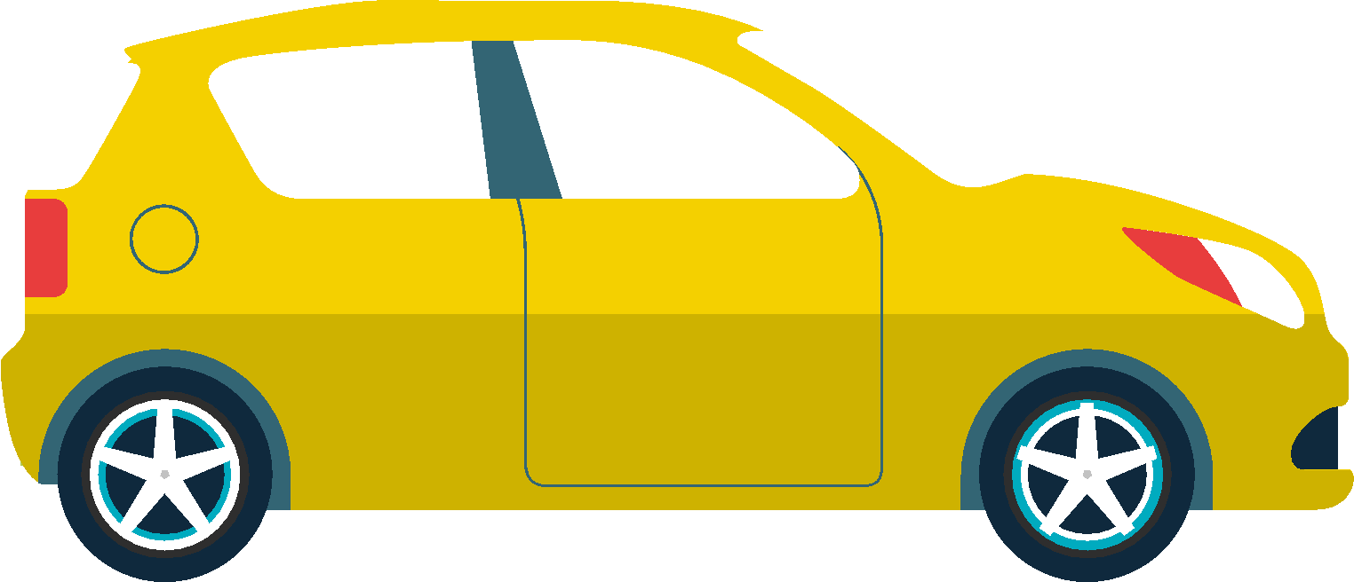
Let’s Brainstorm….
What else can we do to prevent distracted driving?
What are some tips that we could share with our peers?

Slide 55
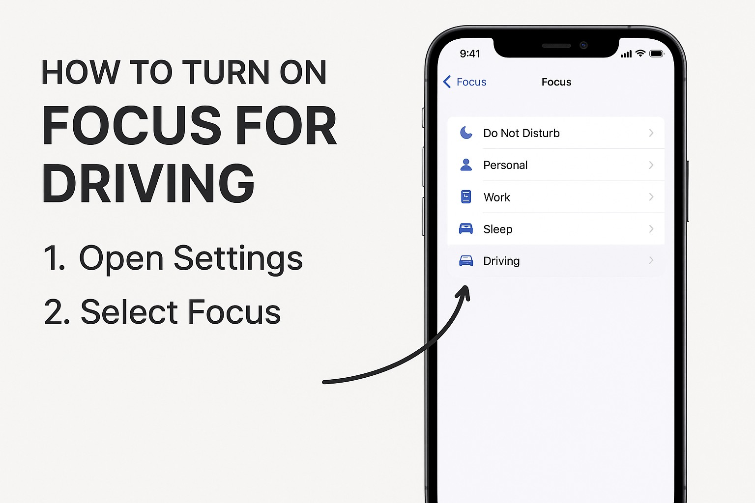
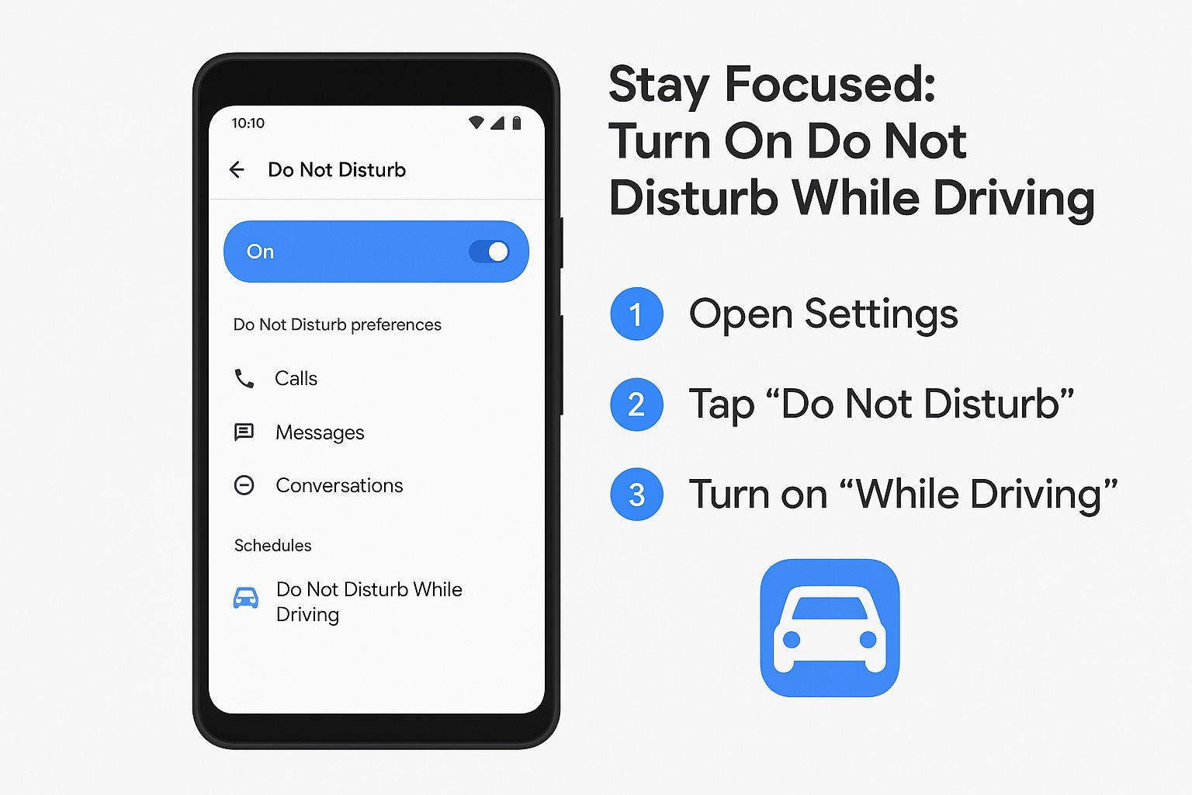
Turn on the technology that limits distractions!
iPhone
Android

